Slide 1
CP Level 2 - Python
Life is short
(You need Python)

Slide 2
Chapter 3 Operators
Arithmetic Operators
Comparison (Relational) Operators
Assignment Operators
Logical Operators
Bitwise Operators
Membership Operators
Identity Operators
Python Operators Precedence

Slide 3
Chapter 3 Arithmetic Operators
+ Addition (Adds values on either side of the operator)
- Subtraction(Subtracts right hand operand from left hand operand)
* Multiplication (Multiplies values on either side of the operator)
/ Division (Divides left hand operand by right hand operand)
% Modulus (Divides left hand operand by right hand operand and returns remainder)
** Exponent (Performs exponential (power) calculation on operators)
// Floor Division (The division of operands where the result is the quotient in which the digits after the decimal point are removed. But if one of the operands is negative, the result is floored, i.e., rounded away from zero (towards negative infinity))

Slide 4
Chapter 3 Comparison Operators
== (If the values of two operands are equal, then the condition becomes true.)
!= (If values of two operands are not equal, then condition becomes true.)
> (If the value of left operand is greater than the value of right operand, then condition becomes true.)
< (If the value of left operand is less than the value of right operand, then condition becomes true.)
>= (If the value of left operand is greater than or equal to the value of right operand, then condition becomes true.)
<= (If the value of left operand is less than or equal to the value of right operand, then condition becomes true.)

Slide 5
Chapter 3 Assignment Operators
= (Assigns values from right side operands to left side operand)
+= Add AND (It adds right operand to the left operand and assign the result to left operand)
-= Subtract AND (It subtracts right operand from the left operand and assign the result to left operand)
*= Multiply AND (It multiplies right operand with the left operand and assign the result to left operand)

Slide 6
Chapter 3 Assignment Operators
/= Divide AND (It divides left operand with the right operand and assign the result to left operand)
%= Modulus AND (It takes modulus using two operands and assign the result to left operand)
**= Exponent AND (Performs exponential (power) calculation on operators and assign value to the left operand)
//= Floor Division (It performs floor division on operators and assign value to the left operand)

Slide 7
Chapter 3 Bitwise Operators
& Binary AND (Operator copies a bit, to the result, if it exists in both operands)
| Binary OR (It copies a bit, if it exists in either operand.)
^ Binary XOR (It copies the bit, if it is set in one operand but not both.)
~ Binary Ones Complement (It is unary and has the effect of 'flipping' bits.)
<< Binary Left Shift (The left operand's value is moved left by the number of bits specified by the right operand.)
>> Binary Right Shift (The left operand's value is moved right by the number of bits specified by the right operand.)
Notes:
&: 同1为1； |： 有1为1； ^：相同为0，不同为1

Slide 8
Chapter 3 Logical Operators and Membership Operators
Logical Operators
and Logical AND (If both the operands are true then condition becomes true.)
or Logical OR (If any of the two operands are non-zero then condition becomes true.)
not Logical NOT (Used to reverse the logical state of its operand.)
Membership Operators
In (Evaluates to true if it finds a variable in the specified sequence and false otherwise)
Not in (Evaluates to true if it does not finds a variable in the specified sequence and false otherwise.)

Slide 9
Chapter 3 Identity Operators
Is (Evaluates to true if the variables on either side of the operator point to the same object and false otherwise)
Is not (Evaluates to false if the variables on either side of the operator point to the same object and true otherwise.)
Notes:
id(object) Return the “identity” of an object. This is the address of the object in memory.

Slide 10
Chapter 3 Python Operators Precedence
1 | Exponentiation (raise to the power) **
2 | Complement, unary plus and minus （~ + -）
3 | Multiply, divide, modulo and floor division (* / % //)
4 | Addition and subtraction (+ -)
5 | Right and left bitwise shift (>> <<)
6 | Bitwise 'AND' (&)
7 | Bitwise exclusive `OR' and regular `OR' (^ |)
8 | Comparison operators (<= < > >=)
9 | Equality operators (< > == !=)
10 | Assignment operators (= %= /= //= -= += *= **=)
11 | Identity operators (is is not)
12 | Membership operators (in not in)
13 | Logical operators (not or and)

Slide 11
Chapter 4 Control Flow
if ...
if … else … or if … elif ...
if … elif … else ...
for … in ...
while
break, continue, else, pass

Slide 12
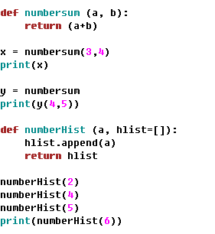
Chapter 4 Control Flow
Defining a function
Notes:
mutable and immutable object
The keyword def introduces a function definition. It must be followed by the function name and the parenthesized list of formal parameters. The statements that form the body of the function start at the next line, and must be indented.

Slide 13
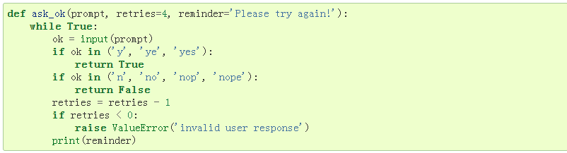
Chapter 4 Control Flow
Defining a function - Default Argument Values
Notes:
The default values are evaluated at the point of function definition in the defining scope. The default value is evaluated only once. This makes a difference when the default is a mutable object such as a list, dictionary, or instances of most classes.

Slide 14
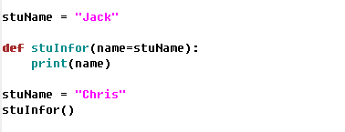
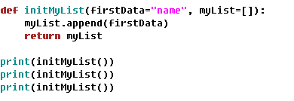
Chapter 4 Control Flow
Defining a function - Default Argument Values
Notes:
The default values are evaluated at the point of function definition in the defining scope.
Important warning: The default value is evaluated only once. This makes a difference when the default is a mutable object such as a list, dictionary, or instances of most classes.

Slide 15
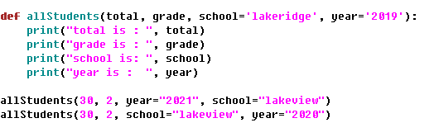
Chapter 4 Control Flow
Defining a function - Keyword Arguments
Notes:
required arguments, keyword argument

Slide 16

Chapter 4 Control Flow
Defining a function - Special Arguments
* (asterisk)

Slide 17

Chapter 4 Control Flow
Defining a function - Special Arguments
** (double asterisk)

Slide 18

Chapter 4 Control Flow
Lambda expressions
lambda [arg1 [,arg2,.....argn]]:expression
Notes:
Small anonymous functions can be created with the lambda keyword

